Slide 1
Dapr Distributed Application Runtime Dapr .NET SDK
DevApps Meetup - Saison 04 Episode 07
Laurent Kempé -   @laurentkempe 9 July 2021

Slide 2















Any cloud or edge infrastructure
Application code
Microservices written in
Any code or framework…
HTTP API
gRPC API
Service-to-service invocation
State management
Publish and subscribe
Resource bindings and triggers
Actors
Observability
Secrets
Extensible
Hosting infrastructure
Azure Arc
On-Premises

Slide 3

Sidecar model
Application
Dapr sidecar
WebSite
Dapr API
HTTP/gRPC
POST http://localhost:3500/v1.0/invoke/cart/method/neworder
GET http://localhost:3500/v1.0/state/inventory/item67
POST http://localhost:3500/v1.0/publish/shipping/orders

Slide 4


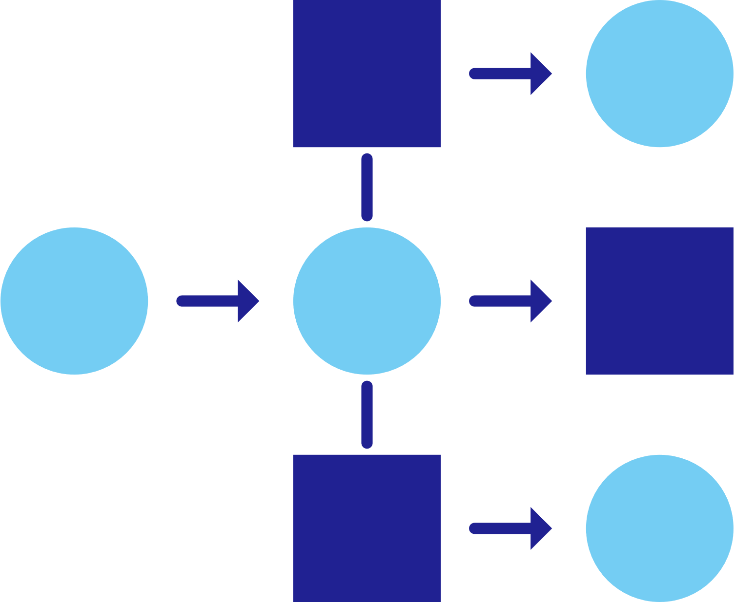






Dapr applications
CounterService
State
Management
Service
Invocation
WebSite
PubSub
Messaging
Bindings
& Triggers
Secret
Management
Virtual
Actors
WeatherService
Observability

Slide 5





















Dapr components
State
Stores
AWS
DynamoDB
Azure
CosmosDB
Firebase
Redis
Cassandra
PubSub
Brokers
AWS
SQS
Azure
Service Bus
GCP
Pub/Sub
Redis
RabbitMQ
My App
Bindings
& Triggers
AWS
S3
Azure
Storage
GCP
Storage
Twilio
Kafka
Swappable YAML files with
resource connection details
Over 70 components available
Create components for your resource at: github.com/dapr/components-contrib
Secret
Stores
AWS
Secrets Manager
Azure
KeyVault
GCP
Secret Manager
HashiCorp
Vault
Kubernetes
Secret
Observability
Prometheus
AppInsights
Zipkin
Jaeger

Slide 6
Dapr state API
corpdb-redis.yaml
apiVersion: dapr.io/v1alpha1
kind: Component
metadata:
name: corpdb
spec:
type: state.redis
version: v1
metadata:
- name: redisHost
value: redis-master.default.svc.cluster.local:6379
- name: redisPassword
secretKeyRef:
name: redis-secret
key: redis-password
Save state
POST /v1.0/state/corpdb
Retrieve state
GET /v1.0/state/corpdb/mystate

Slide 7


Publish and subscribe
pubsub
WebSite
Redis
Cache
CounterService
POST
http://localhost:3500/v1.0/publish/pubsub/counterincremented
POST
{“counter":“2"}
{“counter":“2"}

Slide 8
Dapr pub/sub API
orders.yaml
apiVersion: dapr.io/v1alpha1
kind: Component
metadata:
name: orders
spec:
type: pubsub.redis
metadata:
- name: redisHost
value: leader.redis.svc.cluster.local:6379
- name: redisPassword
secretKeyRef:
name: redis-secret
key: password
- name: allowedTopics
value: "processed,audit"
App-to-sidecar
Publish a message
POST /v1.0/publish/orders/processed
Sidecar-to-app
Get app subscriptions
GET /dapr/subscribe
Publish to app
POST /order-processing

Slide 9


Observability
WeatherService
WebSite
Redis
Cache
CounterService
OpenTelemetry collector
Logging &
tracing extensions

Slide 10
Thank You! 🚀 Laurent Kempé https://laurentkempe.com/  @laurentkempe  @laurentkempe

Slide 11
References
Dapr.io Dapr on Github
Dapr on discord
Dapr for .NET Developers 📘
Learning Dapr - Building Distributed Cloud Native Applications 📘
Dapr SDK for .NET 👩🏼‍💻
eShopOnDapr, .NET distributed application 👩🏼‍💻
My Dapr playground 👩🏼‍💻
My Dapr blog posts

